Slide 1
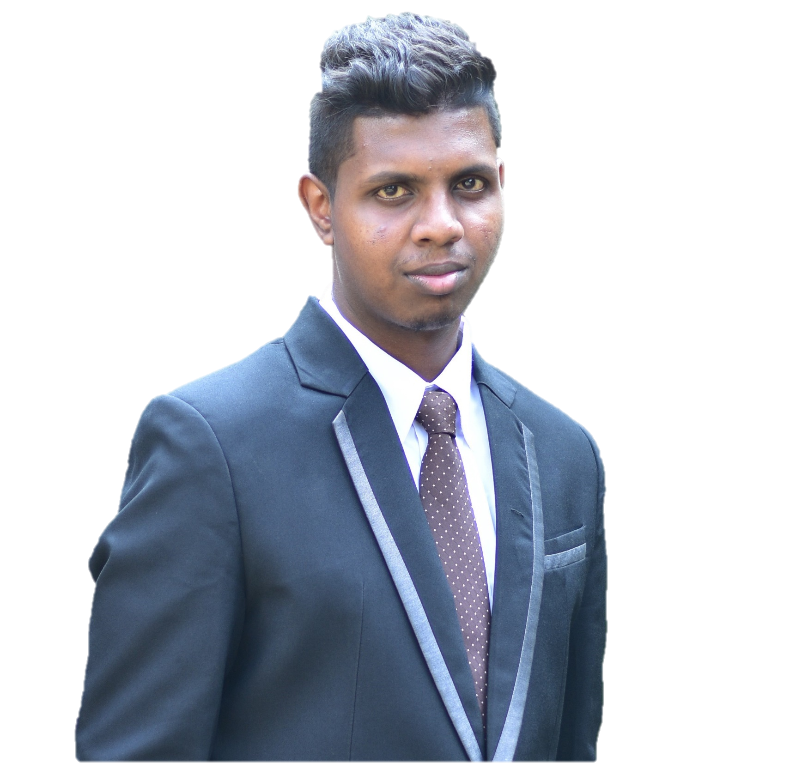
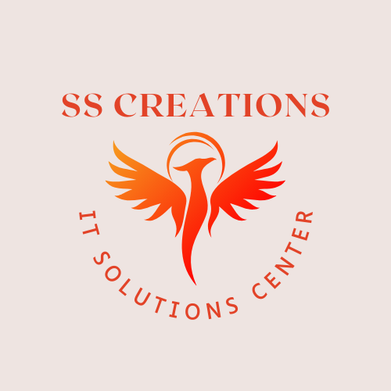

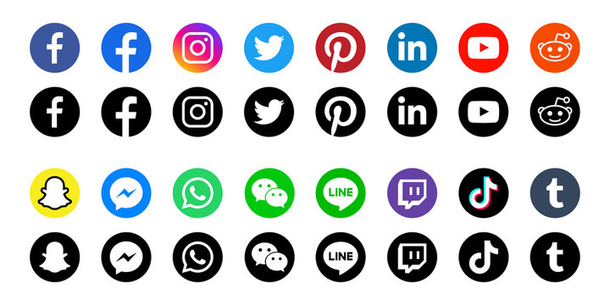

Welcome to SS Creation
Crafting stunning social media posts for your brand

Slide 2
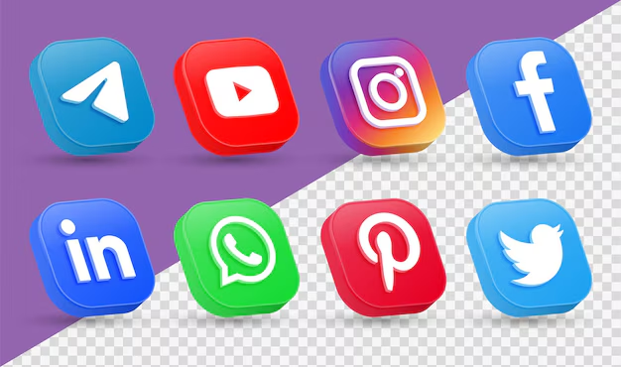

What We Offer
Our vision: "To become a trusted partner for brands worldwide, transforming their social media presence with innovative and impactful designs that captivate audiences and drive engagement.“
Our mission: "At SS Creation, our mission is to craft unique, visually appealing, and brand-aligned social media posts that help businesses connect with their audience, enhance their online visibility, and achieve their marketing goals."
Why Choose SS Creation?
Creative & unique posts: Tailored to your brand’s voice and audience.
Platforms covered: Instagram, Facebook, LinkedIn, Pinterest, and more.
Quick turnaround: High-quality posts delivered on time.
Custom designs: From promotional banners to infographics and story designs.
Affordable packages: Competitive pricing to suit your needs.
Visuals: Use icons representing creativity, speed, affordability, and social media platforms.

Slide 3

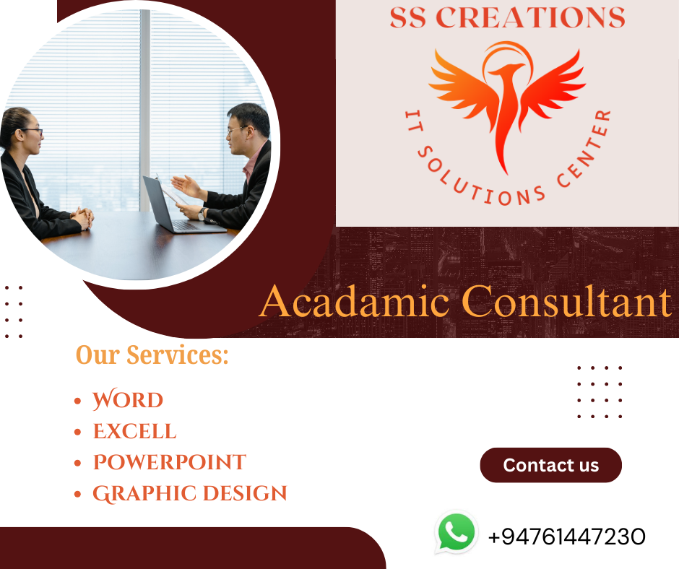



Let's Collaborate
Get Started with SS Creation Today!

